Slide 1
Prairie Creek Trail Development
Public & Stakeholder Engagement
Cassandra Dell’Aquila & John Buchko, EDS Group Inc.
Parks – Represented by Pankaj Harsora
December 14, 2022

Slide 2
Please note, this session is being recorded so that it can be shared on the Participate Wood Buffalo project page.

Slide 3
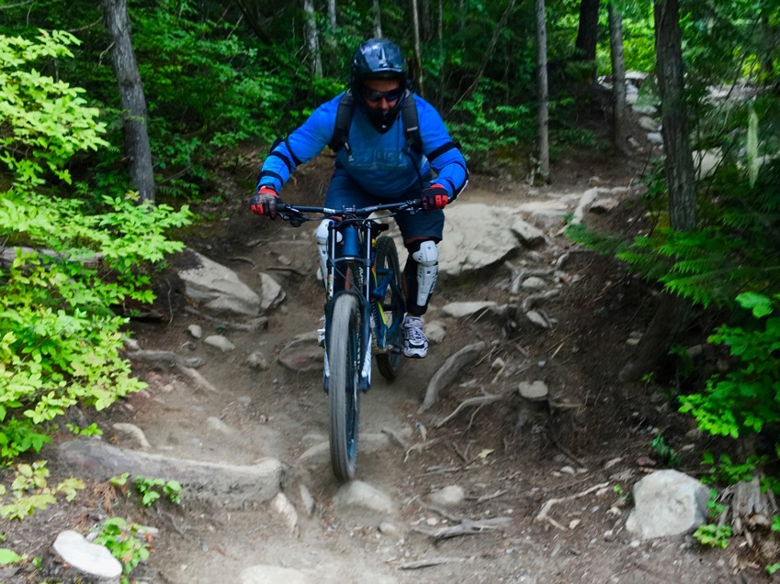
Session Summary
Introductions & methods to ease participation
About the project
Study process
Project goals
Site constraints
Trail alignment options
Next steps
Open discussion

Slide 4

Introductions
Are you here representing a user group or are you a resident of the community?
What would make it easier for you to participate today? (i.e., everyone speaking loudly and clearly, having the facilitator stop and ask if there are questions instead of using the raise hand button, etc.)
Are there any topics not listed in the agenda you want to make sure we discuss today?

Slide 5
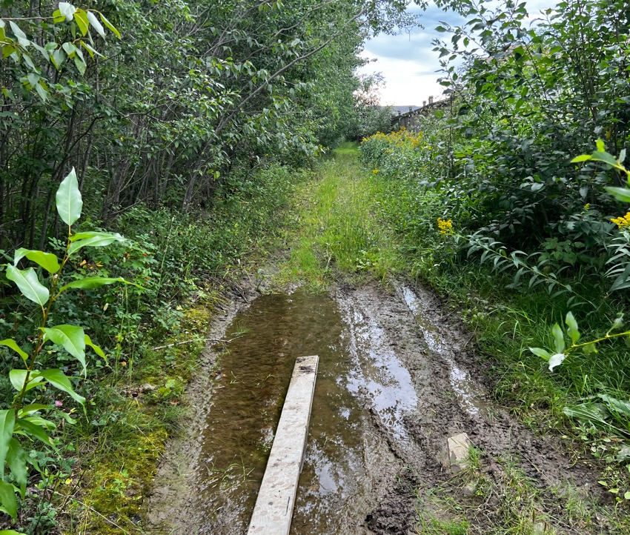
About the Project
Need for trails was identified approx. 5 years ago
Improvements to landscaping along Hwy 69 (Saprae Creek Trail)
No existing trails: some informal trails along south and west sides
Options for trail development completed about 4 years ago
Prairie Creek Trail Development

Slide 6

Project Goals
To provide active transportation and recreation opportunities in this residential community
To determine safe and feasible trail routes for a continuous paved trail system
To obtain necessary approvals and agreements required
To develop detailed drawings for future implementation
Prairie Creek Trail Development

Slide 7
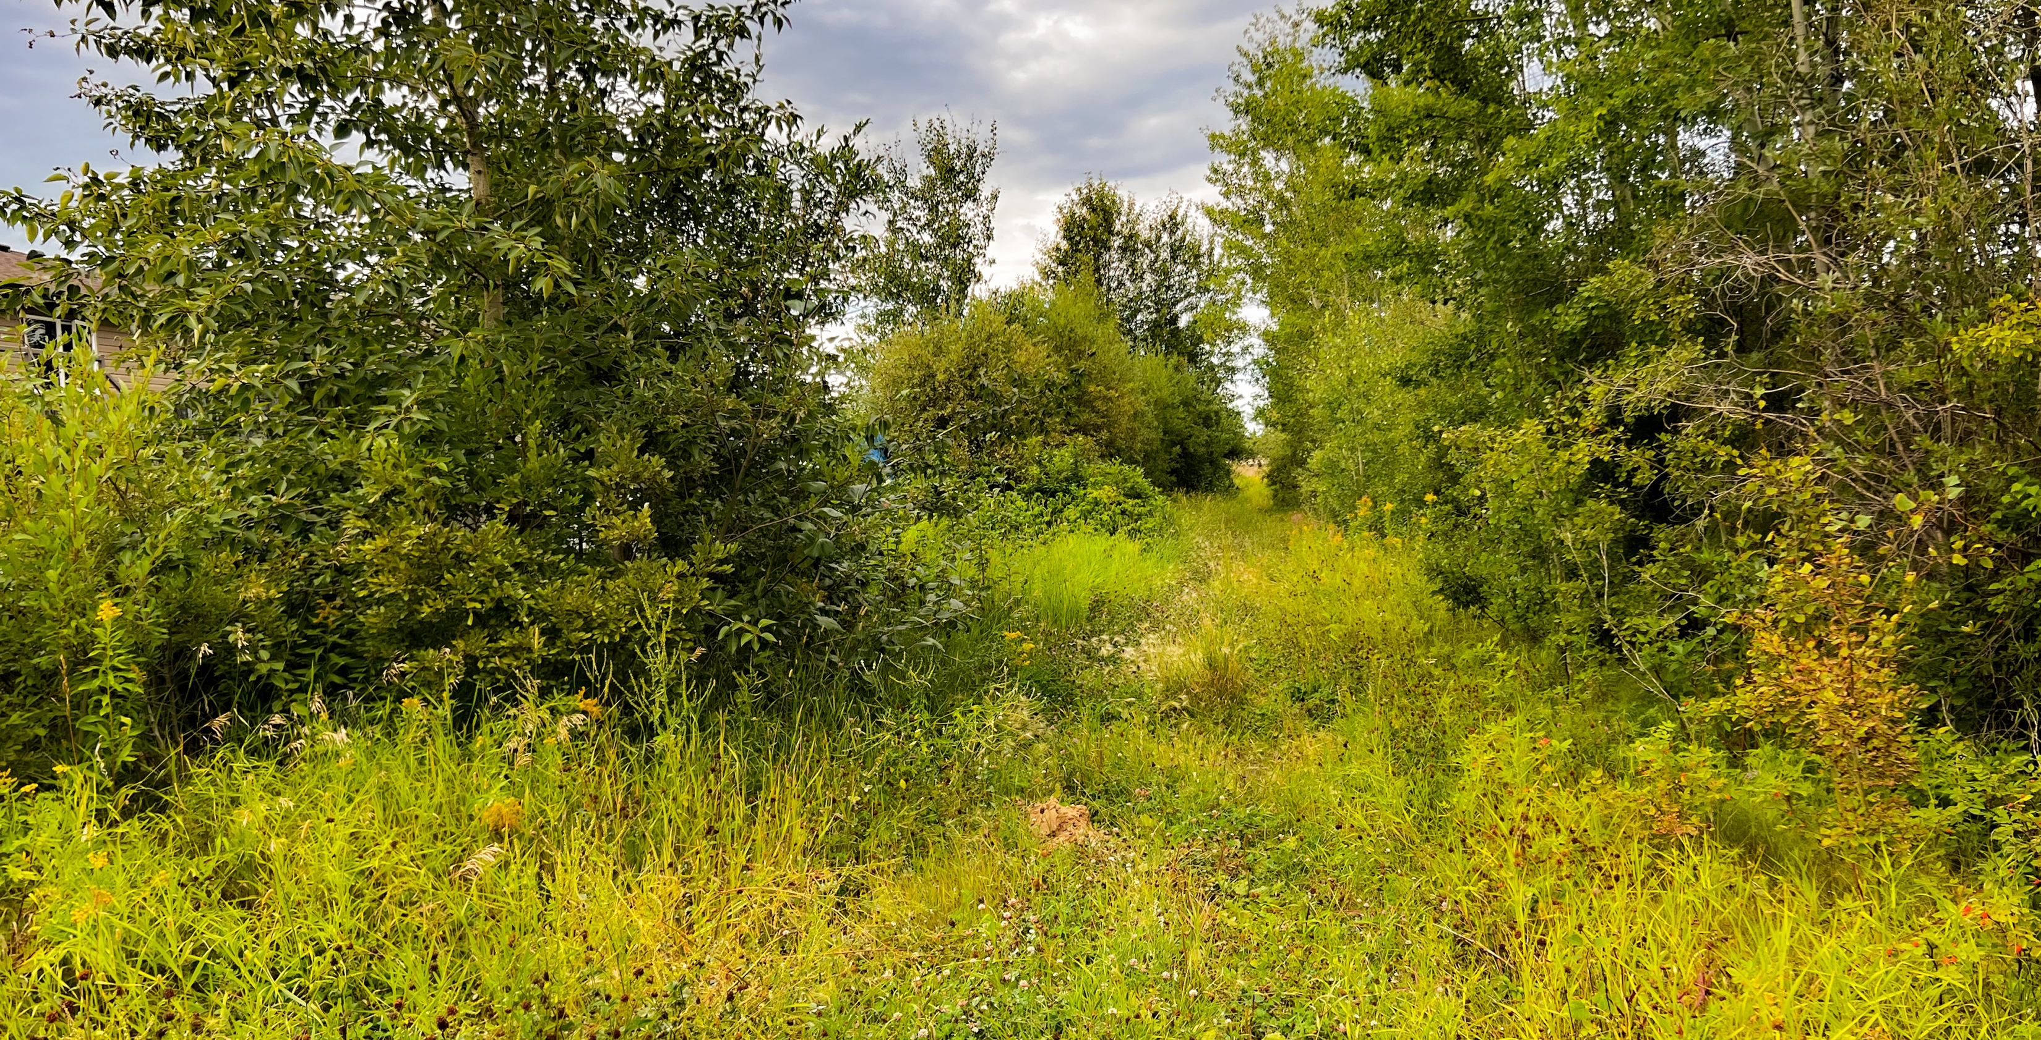
ACTIVITY: Project Goals
What are your top 3 values from the list below we should consider when developing the Prairie Creek trail?
    Preservation of existing vegetation
    A continuous loop around the community
    Better connectivity within the community
    Best value for tax dollars
    A trail that supports multiple users (i.e., walking, biking)
    Other?
Prairie Creek Trail Development

Slide 8
Study Process
Assessment of existing conditions for the trail
Discussions with internal RMWB staff, initial stakeholder & public workshop
Online public engagement using Participate Wood Buffalo
Finalize proposed alignment, start detailed design
Follow-up workshop with residents and stakeholders to review draft design
Prepare "What We Heard Report" summarizing engagement
Finalization of detailed drawings, specifications, tender package

Slide 9
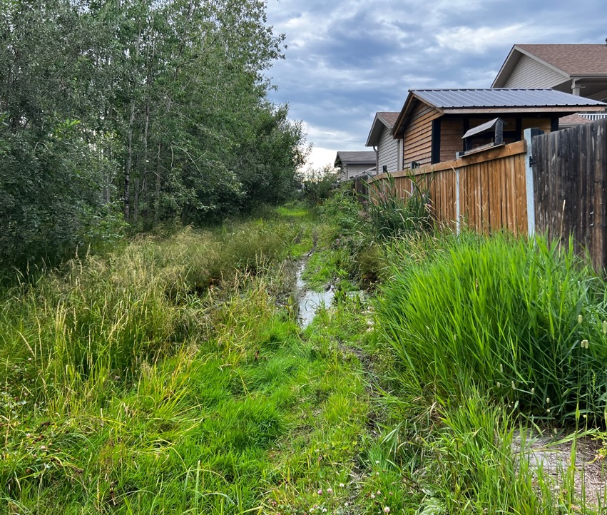
Site Constraints
Very poor drainage in many areas
Provincial approvals required for land to the west, south and east: Provincial land
Clearwater Horse Club land to the south
North trail segment sacrifices trees recently planted, or goes in an undesirable ditch location
Indigenous land interests in a portion of the proposed alignment at south-west corner
Prairie Creek Trail Development

Slide 10
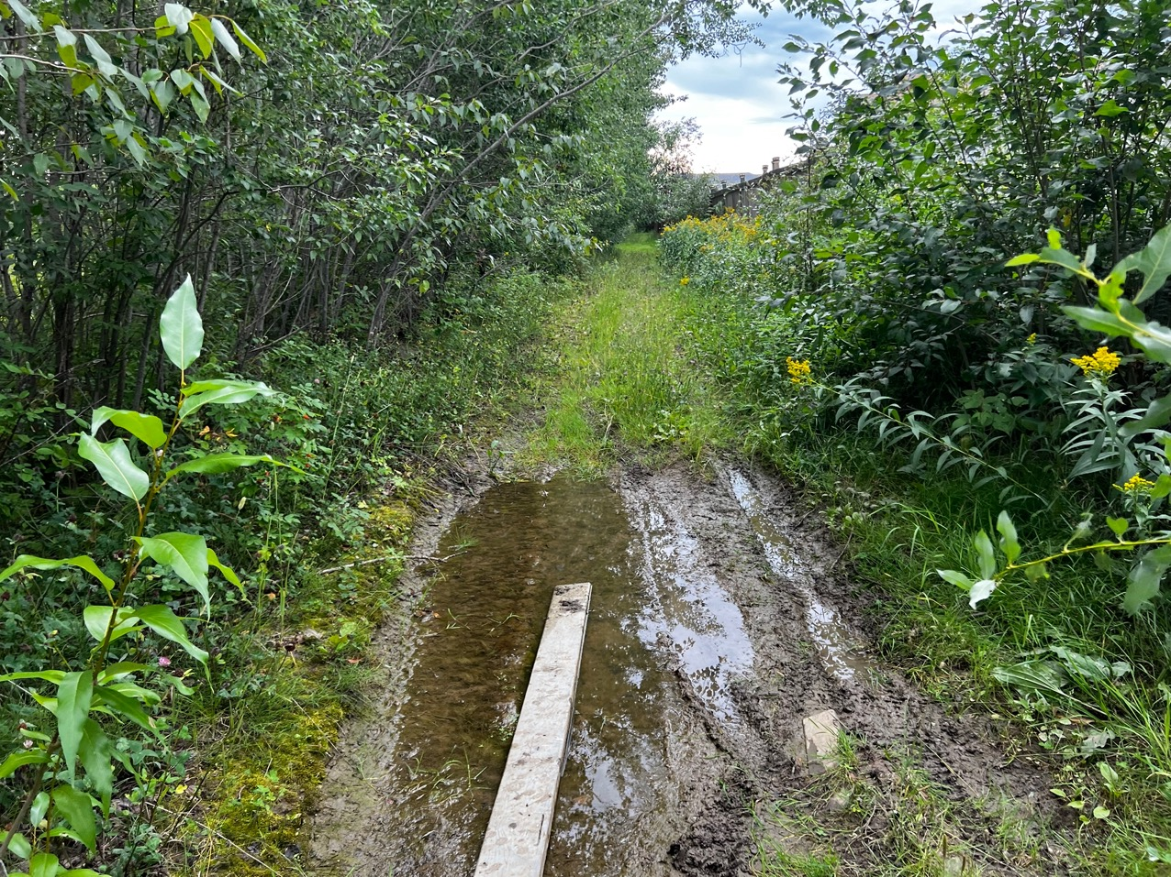
Prairie Creek Trail Development

Slide 11
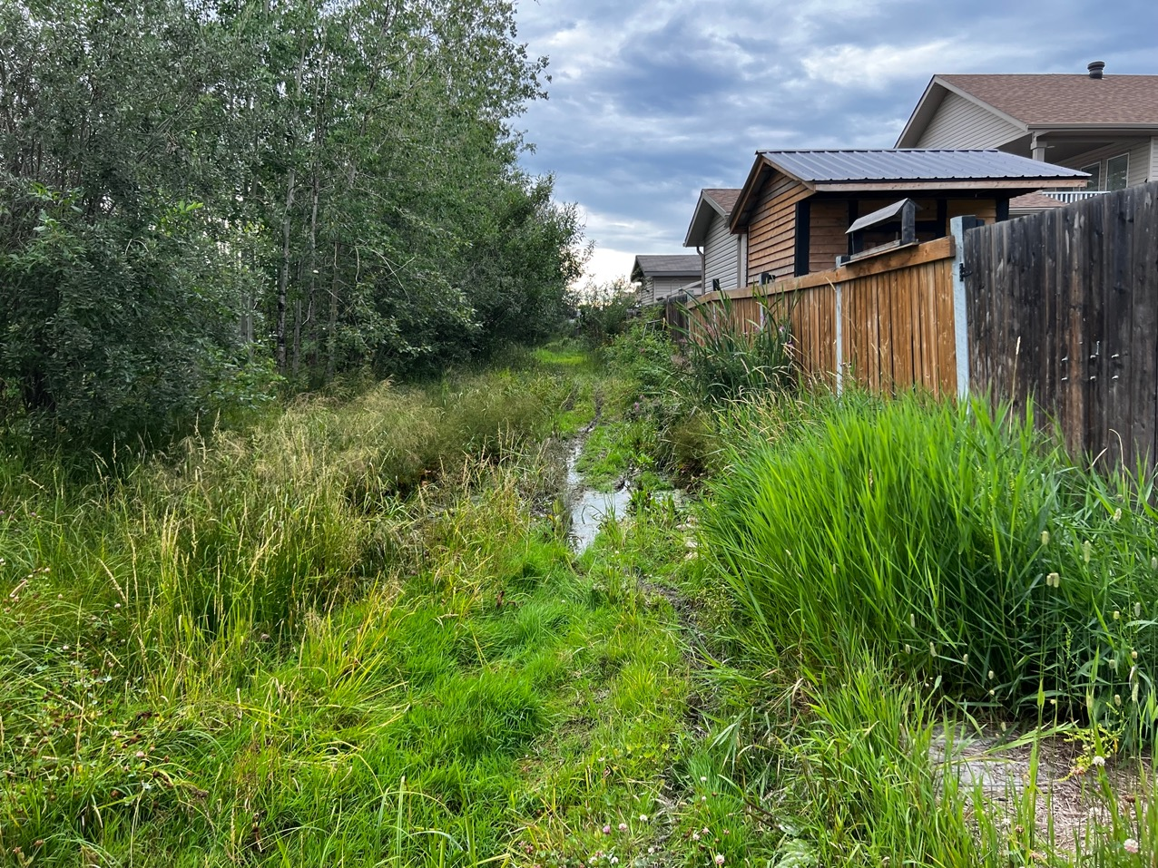
Prairie Creek Trail Development

Slide 12
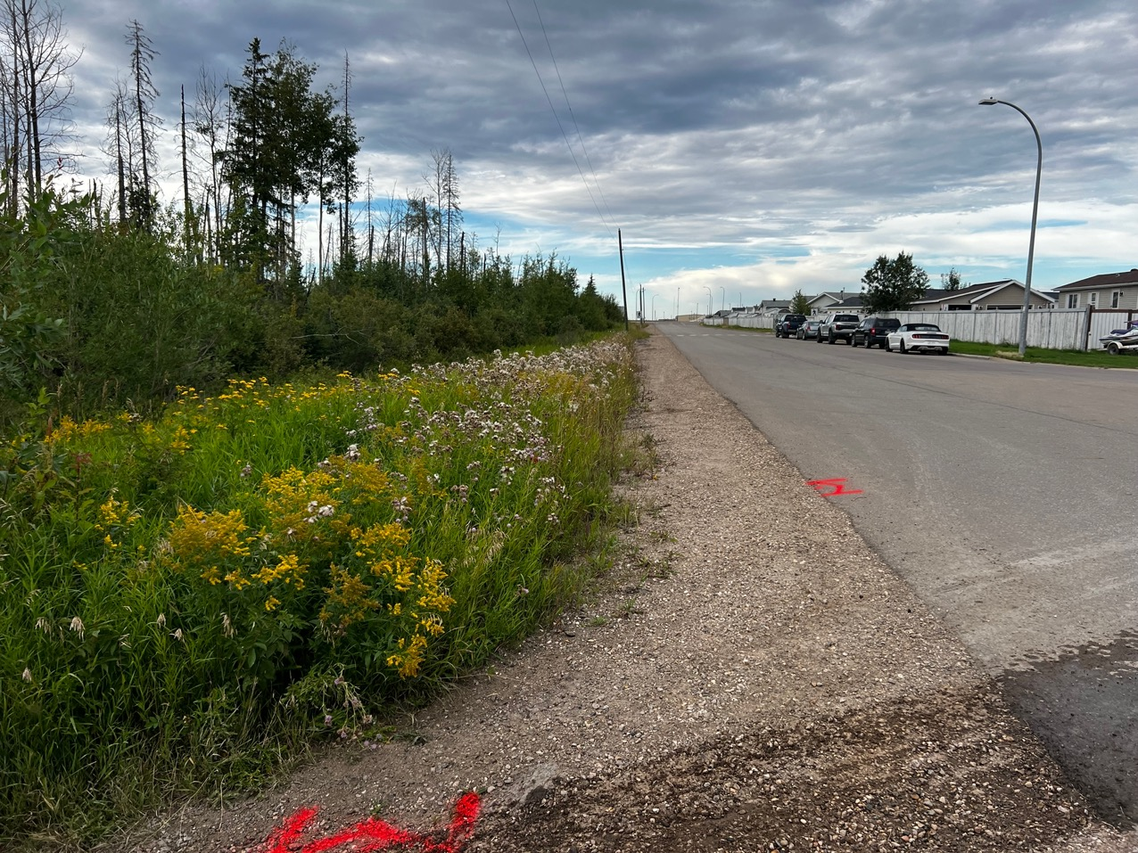
Prairie Creek Trail Development

Slide 13
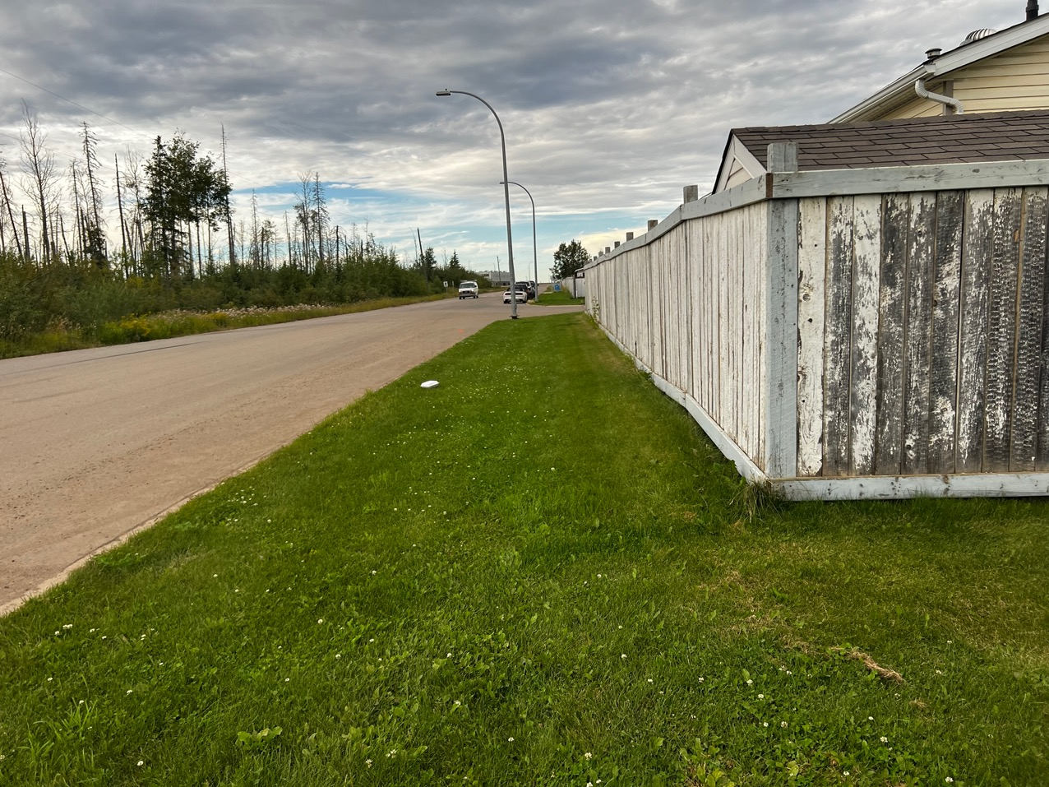
Prairie Creek Trail Development

Slide 14
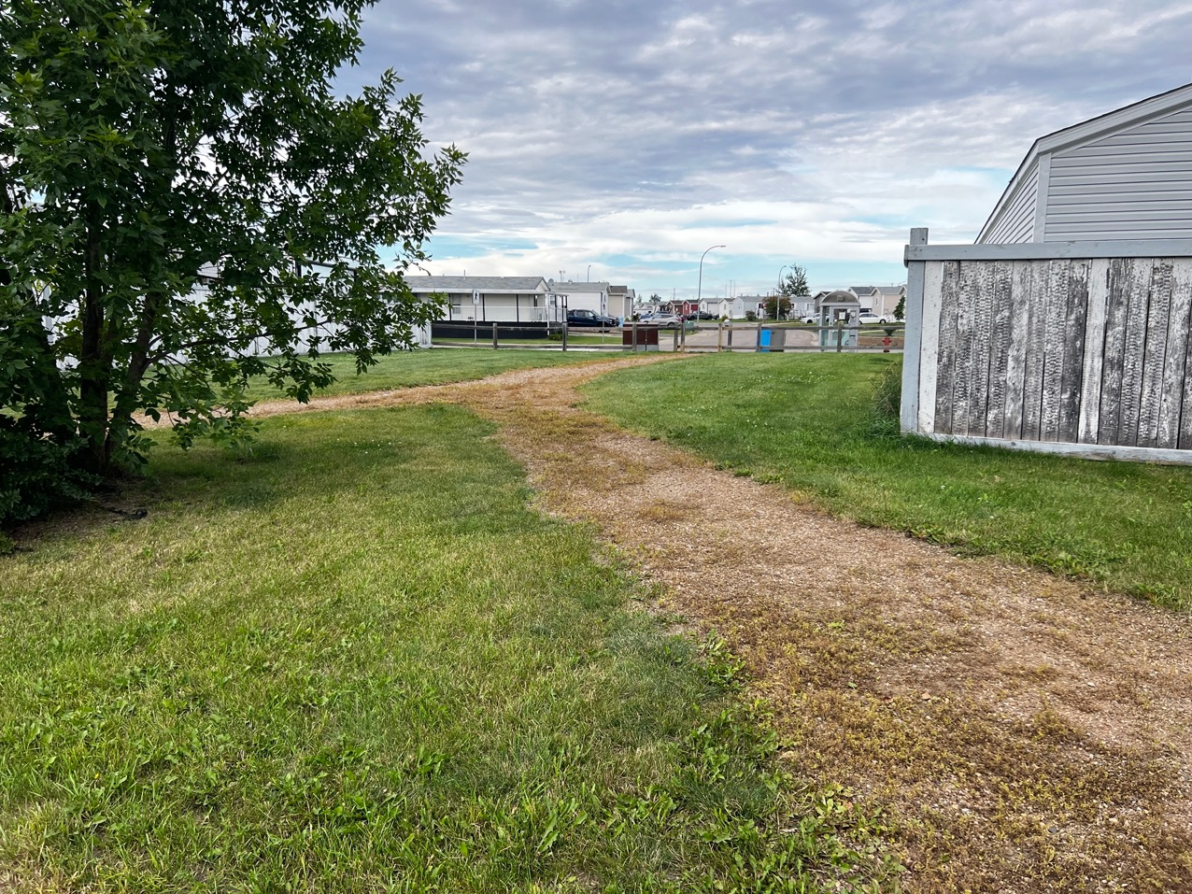
Prairie Creek Trail Development

Slide 15
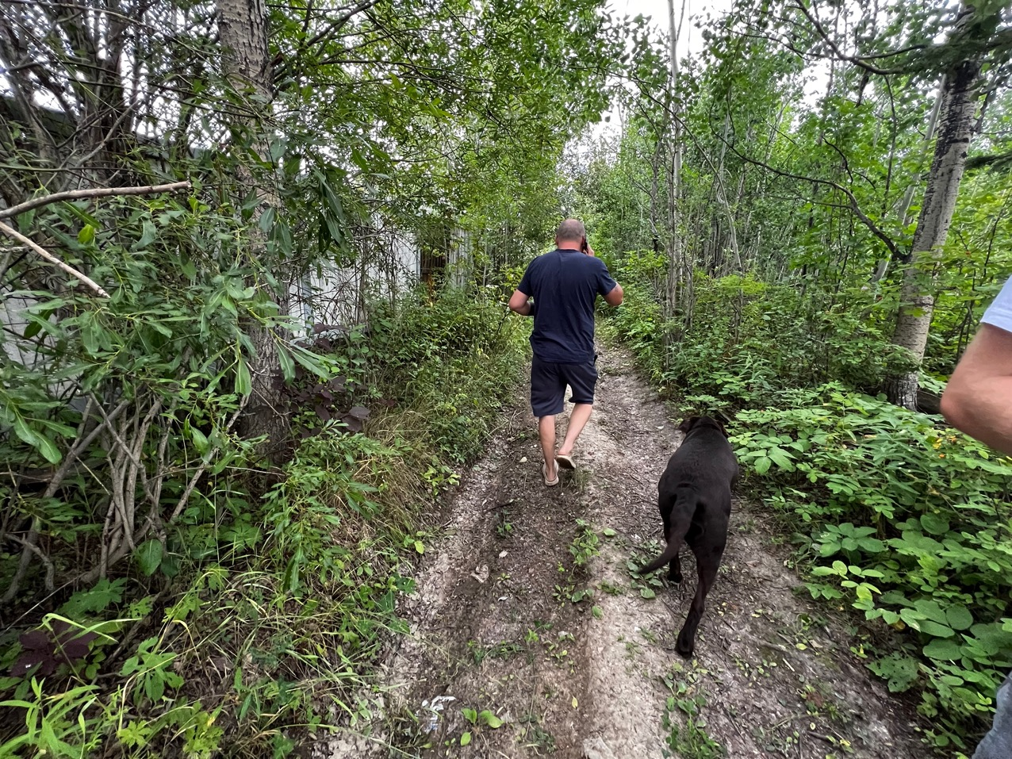
Prairie Creek Trail Development

Slide 16
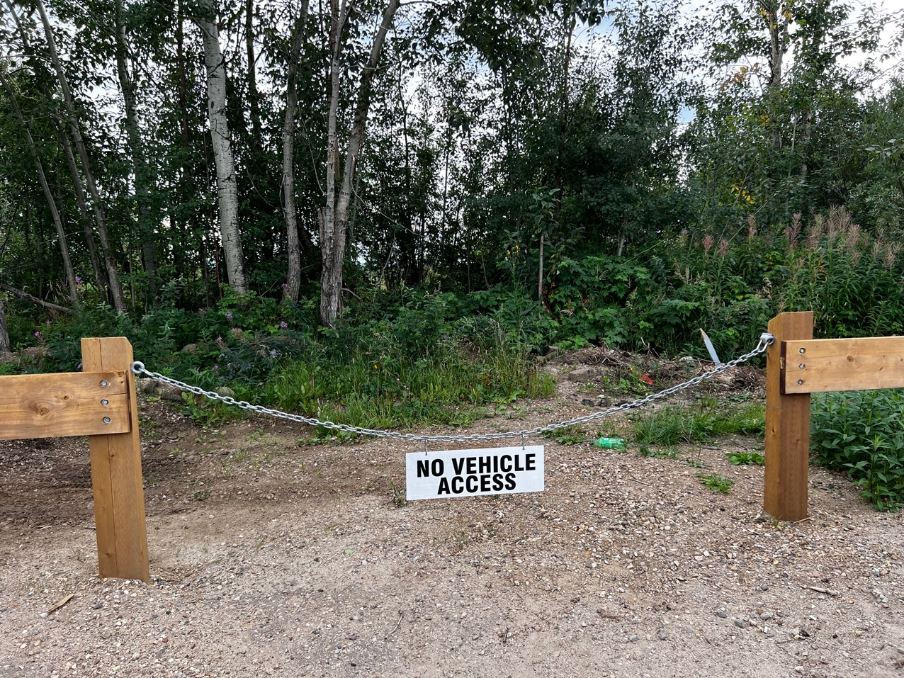
Prairie Creek Trail Development

Slide 17
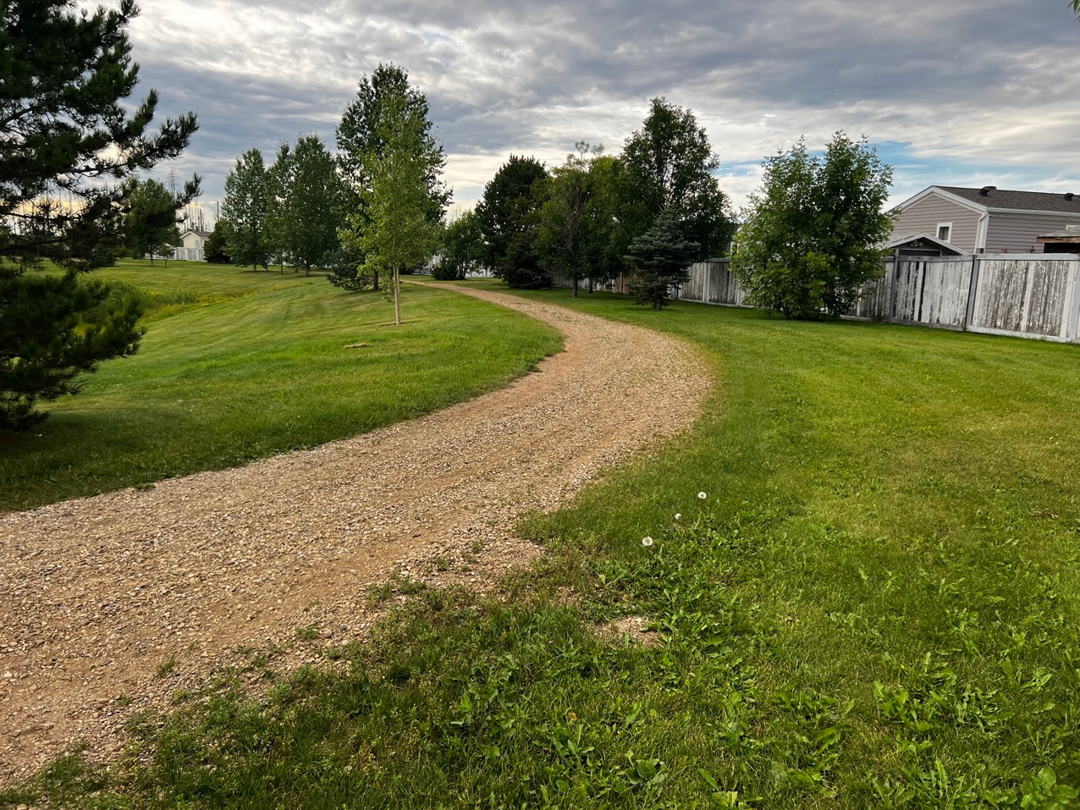
Prairie Creek Trail Development

Slide 18
ACTIVITY: Site Constraints
Are there any other site constraints we should be aware of?
  Think about trail location, views, sounds, smells, and any other site conditions that may complicate trail planning.
Prairie Creek Trail Development

Slide 19
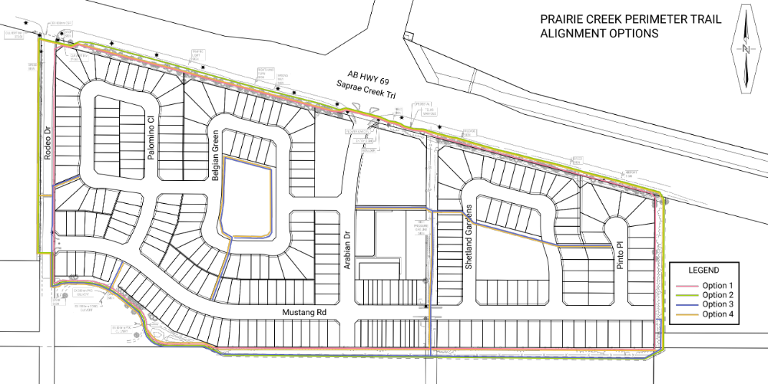
Prairie Creek Trail Development

Slide 20
Prairie Creek Trail Development

Slide 21
Prairie Creek Trail Development

Slide 22
Prairie Creek Trail Development

Slide 23
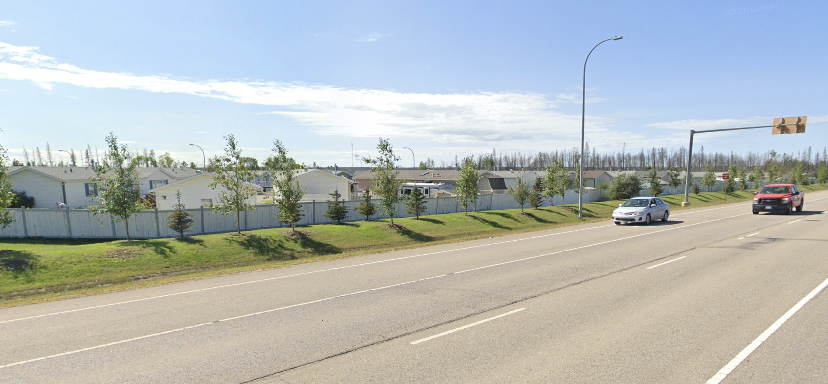
Prairie Creek Trail Development

Slide 24
Prairie Creek Trail Development

Slide 25
Prairie Creek Trail Development

Slide 26
Prairie Creek Trail Development

Slide 27
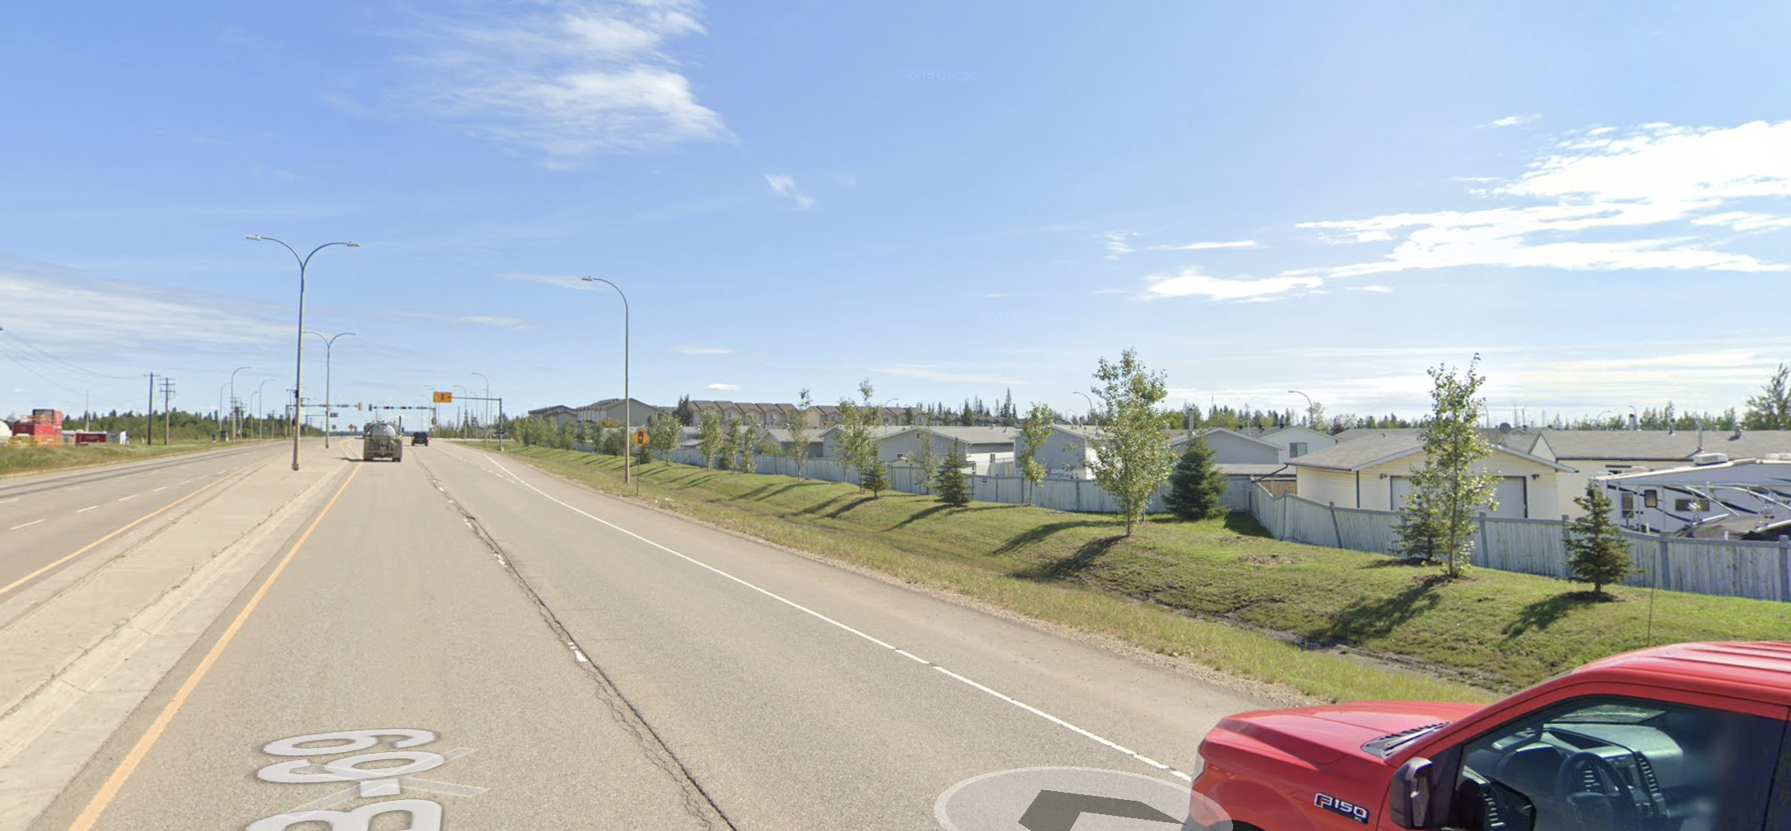
Prairie Creek Trail Development

Slide 28
Prairie Creek Trail Development

Slide 29
Prairie Creek Trail Development

Slide 30
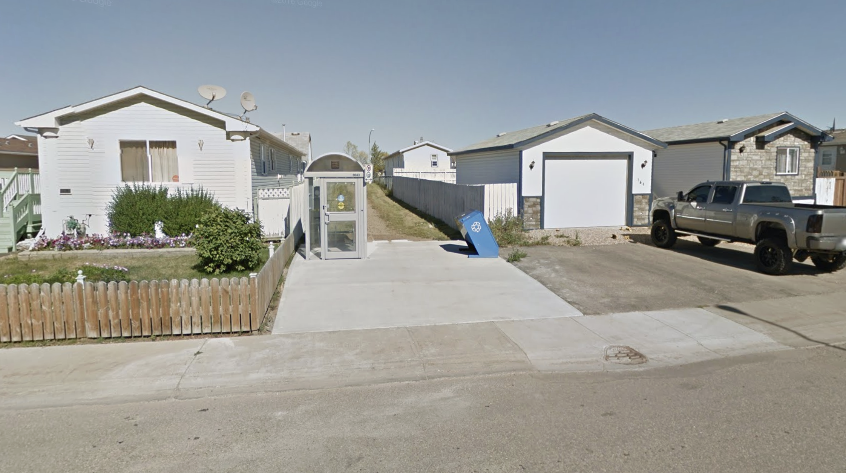
Prairie Creek Trail Development

Slide 31
Prairie Creek Trail Development

Slide 32
Prairie Creek Trail Development

Slide 33
Prairie Creek Trail Development

Slide 34
Prairie Creek Trail Development

Slide 35
Prairie Creek Trail Development

Slide 36
Prairie Creek Trail Development

Slide 37
ACTIVITY: Preferred Trail Alignment
What do you like about each of the alignment options?
Do you have concerns with any of the alignments?
Prairie Creek Trail Development

Slide 38

Next Steps
Online public engagement using Participate Wood Buffalo (survey open until January 9th)
Finalize proposed alignment, start detailed design
Follow-up workshop with residents and stakeholders to review draft design (likely end of January)
Following completion of engagement, a "What We Heard Report" will be created and shared with residents on this project page
Finalization of detailed drawings, specifications, tender package
Prairie Creek Trail Development

Slide 39

Open Discussion
Time to look at some of the topics that were added to today’s discussion at the onset of the workshop
Anything else to discuss?
Questions?
Prairie Creek Trail Development

