Slide 1
What We Heard Report
Saprae Creek Estates Drainage
June 1, 2026

Slide 2
We humbly acknowledge that the land on which we live, learn, work and play is Treaty 8 Territory, the traditional lands of the Cree, Dene, and the unceded territory of the Métis.

Slide 3
TABLE OF CONTENTS
Executive Summary
Key Findings/Themes
Engagement Participants
Engagement in Numbers
Next Steps
Appendices​
    Survey Responses​

Slide 4

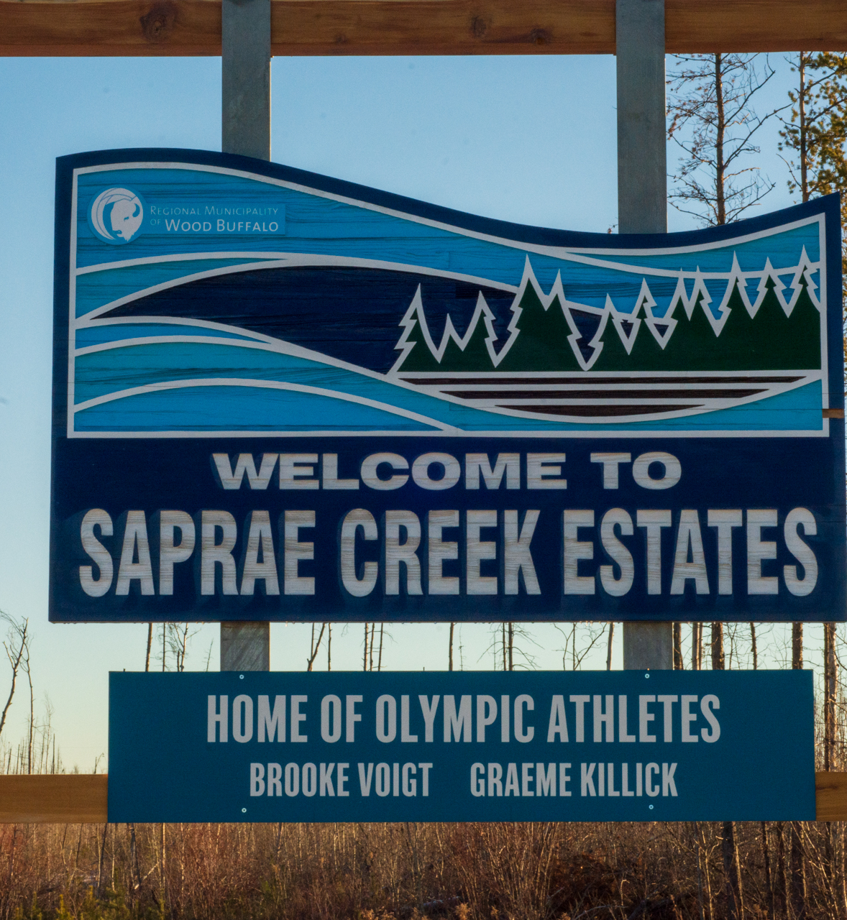
EXECUTIVE SUMMARY
From Mar. 19 to May. 30, 2026, residents were able to participate in an online survey to discuss drainage issues they may be experiencing.
The survey responses indicate that drainage challenges are a significant concern for many residents, particularly during seasonal weather events. The most commonly reported issue was standing water, followed by water not draining from easements.

Slide 5
KEY FINDINGS/THEMES
Seasonal challenges
Drainage problems are heavily influenced by seasonal conditions. Nearly three-quarters of respondents (72.6%, 69 responses) experience issues during spring melt, while over half (50.5%, 48 responses) reported problems during heavy rain events.
22.1% of respondents (21 responses) indicated they experience drainage concerns year-round, highlighting ongoing infrastructure or grading challenges in some areas.
Location
The issues are most frequently occurring in front yard ditches, identified by 56.8% of respondents (54 responses).
Other common locations included backyards and culverts, each reported by 29.5% of respondents (28 responses), as well as along property line easements (28.4%, 27 responses).
Some respondents also noted concerns related to neighboring properties (17.9%, 17 responses), suggesting that drainage impacts are often interconnected between adjacent lots.
Saprae Creek Estates Drainage What We Heard Report

Slide 6
ENGAGEMENT PARTICIPANTS
Who did we talk to?
How did they participate?
Saprae Creek residents
Online survey
Saprae Creek Estates Drainage What We Heard Report

Slide 7
ENGAGEMENT IN NUMBERS
aware
Ways people saw communications and advertisements.
 | Saprae Creek Estates newsletter
 | Door knockers
 | Digital community signage
engaged
Times people took action to provide feedback
95 | Survey responses
Saprae Creek Estates Drainage What We Heard Report

Slide 8
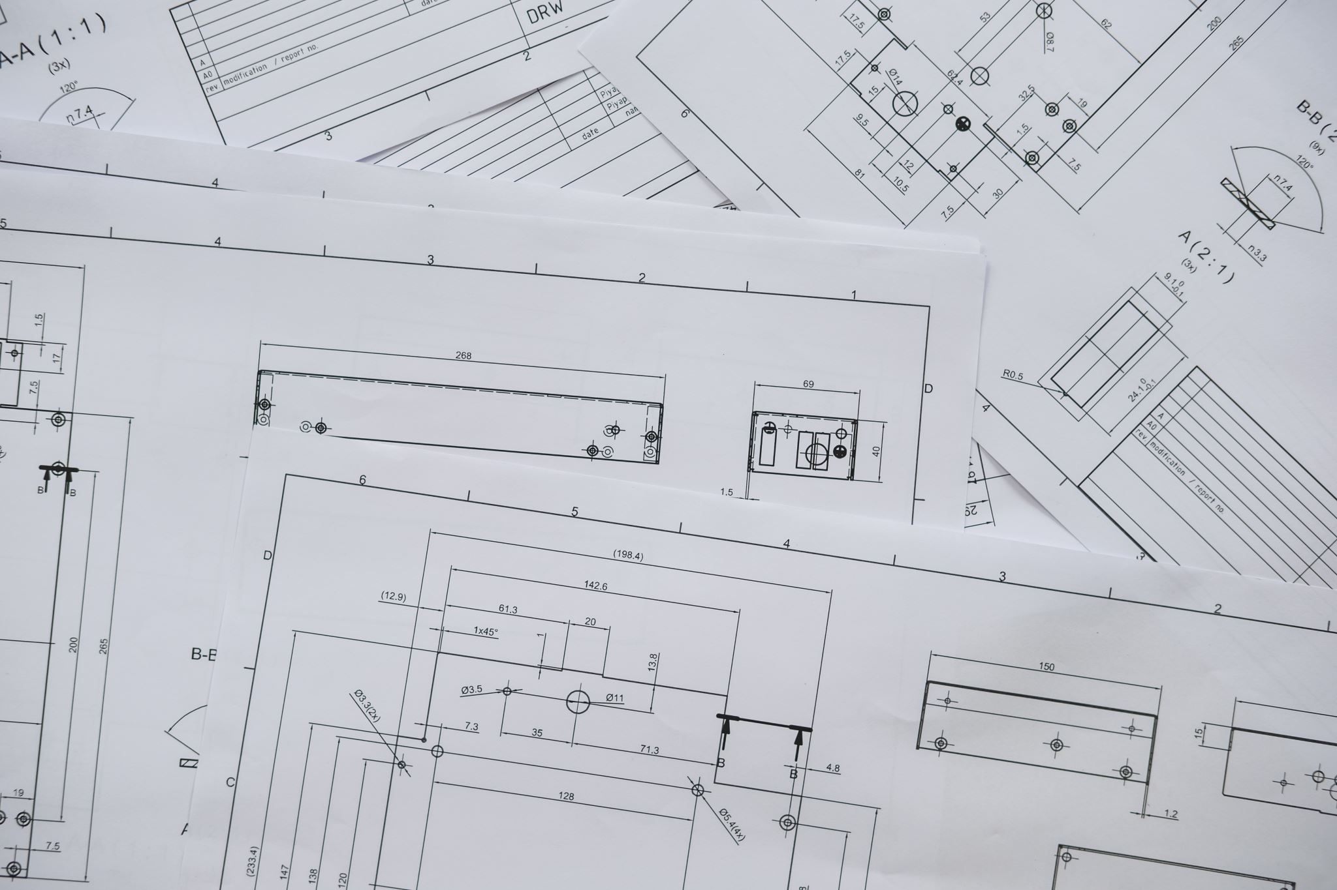
NEXT STEPS
The Project Management Office is reviewing feedback and evaluating drainage conditions within the municipal easements and rights-of-way, including ditches and related infrastructure.
The Municipality is working toward advancing remediation works during the 2026 construction season
Saprae Creek Estates Drainage What We Heard Report

Slide 9
For more information on this report contact rmwb.ca/pulse.

Slide 10
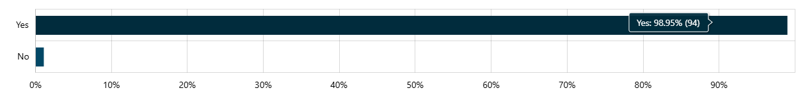
SURVEY RESPONSES
95 total survey responses
Respondent breakdown:
94 respondents identified as Saprae Creek Estate residents (98.95%)
95 total respondents
Q1 – Are you a Saprae Creek Estate resident? (required)
(Total of responses per question)
Saprae Creek Estates Drainage What We Heard Report

Slide 11
Q2 –What drainage issues are you currently experiencing, if any, on or near your property? (required) 95 total respondents
57.89%
43.16%
26.32%
18.95%
Other: examples include drainage infrastructure concerns such as incomplete or ineffective berms, ditches and fire hydrants. Several responses include impacts from neighbours.
13.68%
Saprae Creek Estates Drainage What We Heard Report

Slide 12
Q3 – Where is the drainage issue/ issues located? (required)
95 total respondents
56.84%
29.47%
29.47%
28.42%
Saprae Creek Estates Drainage What We Heard Report

Slide 13
Q4 – How often do you experience this issue? (required)
95 total respondents
72.63%
50.53%
22.11%
13.68%
5.26%
Responses
Saprae Creek Estates Drainage What We Heard Report

Slide 14
Q5 – Are there any features within or near the drainage easement on your property? (required) 95 total respondents
51.58%
37.89%
25.26%
10.53%
Responses
Saprae Creek Estates Drainage What We Heard Report

